Slide 1





The Fourth Industrial Revolution
The Learning Health System
Evert Jan Hoijtink – Founder & CEO
Mark Sluiter – Chairman Task Force Health Care Russia &
Director Portavita Russia
Amsterdam, the Netherlands

Slide 2
Statements Portavita
Evert Jan Hoijtink: “We envision a world where healthcare providers, patients and citizens can digitally and securely share all relevant information, to help create a healthier society.
Our Integrated Care System already assists and enhances the prevention, diagnosis, treatment, monitoring and management of health and lifestyle”

Slide 3
Portavita | A proven -15 year - track record
> 500.000 patients:
  Anticoagulation
  Diabetes
  Cardiovascular Risk
  Management
  Asthma / COPD
  Elderly Care
>100.000 patients performing
self management
10.000 medical professionals
70 Customers
medical organizations and regions
Customers in the Netherlands, Russia and South America
Since 2017 ICDC is official Anticoagulation Expert Center for Russia
Platform for prevention, chronic care and personalized telemedicine
Total 542.000 patients
Anticoagulation 250.000
Cardiovascular Risk Management
Diabetes
Asthma/COPD
| | | |
2001 2005 2010 2015
Elderly Care

Slide 4


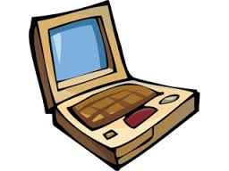

Blueprint | Learning Health System
Simple Task Delegation
Complex tasks execution
New Health Delivery Centers
Elderly / Nursing Homes
Hospitals
Health Data
Health Data
Health Data
Health Data
University
Medical Centers
Outpatient
Clinics
Homecare
Teams
Health Data
Health Data
Health Data
Integrated Care System: Triage, Protocol Management, Workflow, Authorization, BI, ...
Decision Support
Regional
Personal Health
Records
Virtual Expert Clinics
University
Medical Centers
Research
Knowledge

Slide 5
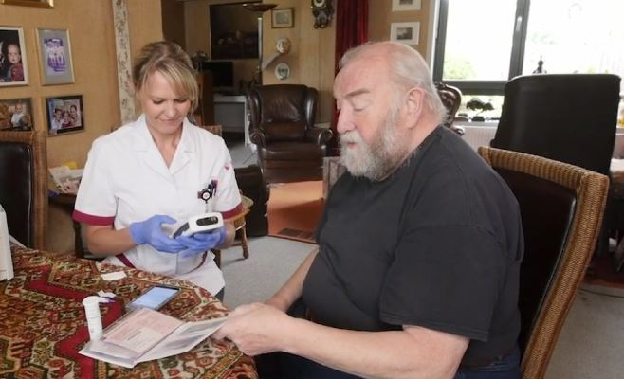

Slide 6


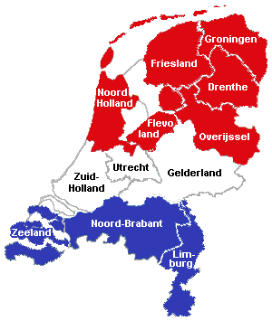
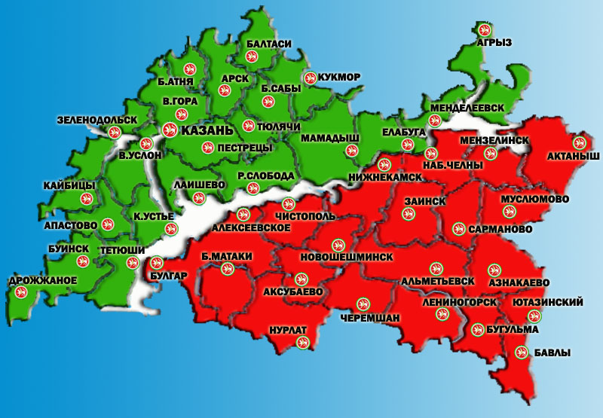
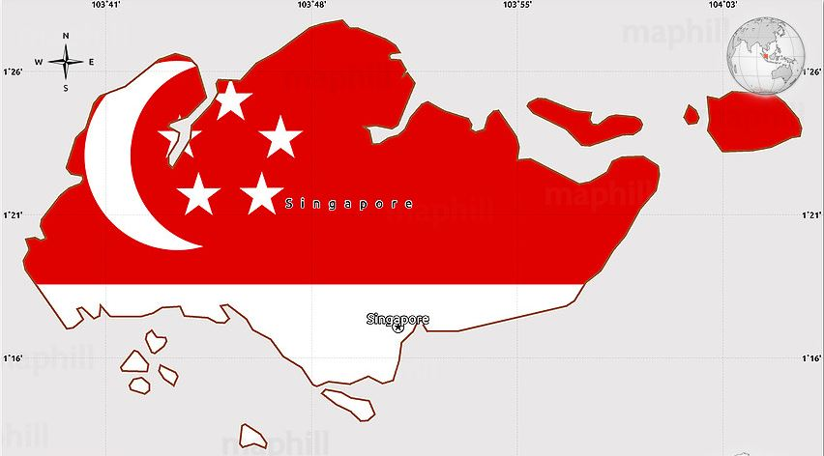
Strategic Alliance:
Netherlands, Tatarstan, Singapore
Selection of partner countries based on innovative governments and entrepreneurship
Market and thought leadership
Proven concepts
Pilots, roll-out
Capacity building
Netherlands: Health Innovation
Tatarstan: IT Excellence and IT Capacity
Singapore: Scientific and Applied Medical Research

